Slide 1
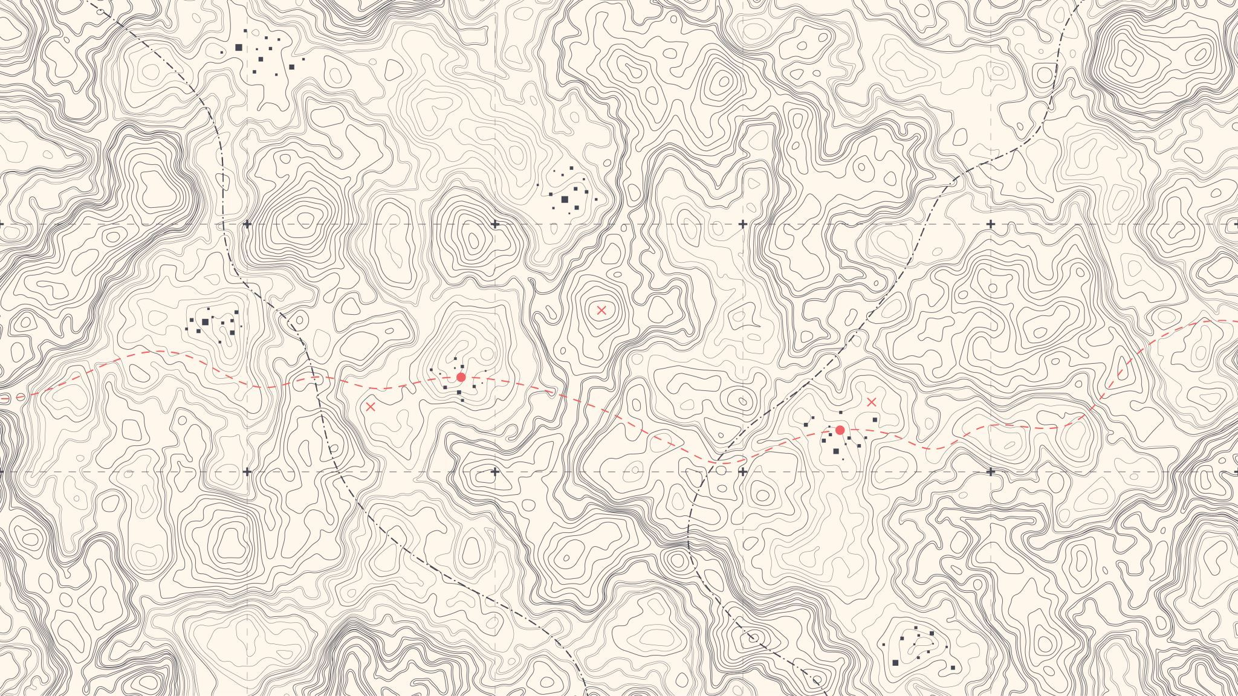
Air Pollutant Mapping
Benjamin Davis, Jack Myhre, Nathan Vu

Slide 2
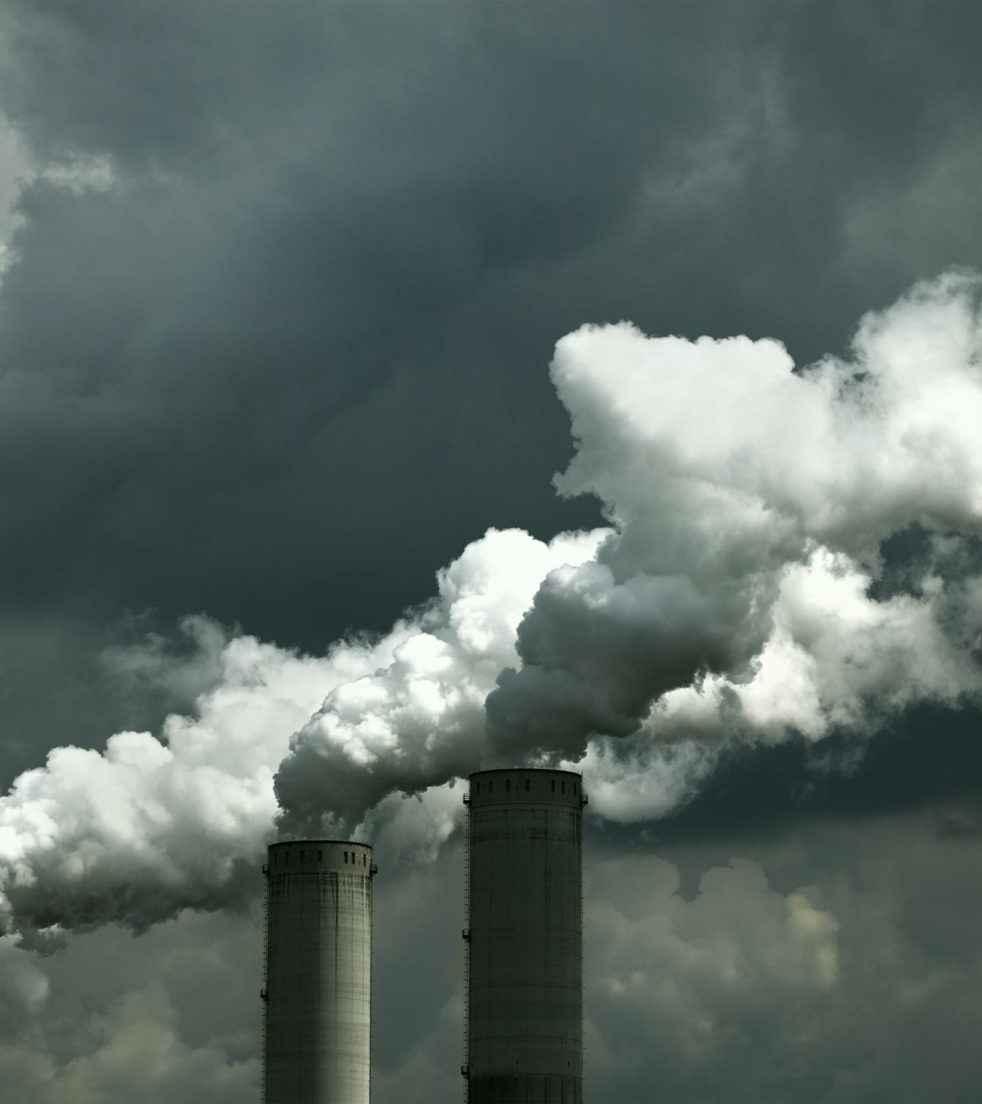
Problem Statement
In urban and industrial areas, air pollution has become a significant issue. And in most cases, monitoring air quality using standard methods is usually high cost.
Unique and safer method to navigate gas leaks and dangerous areas with extremely poor air quality.

Slide 3
Idea
Use ESP8266 Microcontroller, Quadcopter
Use a BME680 sensor to capture temperature, pressure, humidity, and KOhms of the gas
Use a Ublox NEO-6M module to capture coordinates (longitude and latitude) of the drone and timestamp
Use Google Maps API to construct a map of gas concentrations at different locations and times

Slide 4
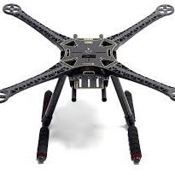
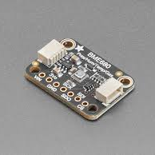
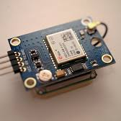
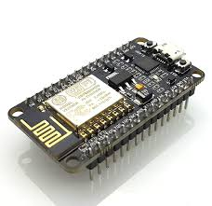
Quadcopter Frame
Gas Sensor
GPS module
ESP8266

Slide 5
Timeline
Stage 1 – Apply for grants and order parts necessary for the drone
Stage 2 – Building drone base
Stage 3 – Adding additional sensors (gas detection, GPS)
Stage 4 – Write script to gather necessary information
Stage 5 – Generate a dataset and load it into Google Maps API to generate report

Slide 6
Resources
ESP8266 Microcontroller
BME680 Sensor
Ublox NEO-6M module
S500 Quadcopter Frame Stretch X FPV Drone Frame Kit PCB

Slide 7
Questions?

Slide 8
Sources/HR
Slides in Canvas
https://www.bosch-sensortec.com/products/environmental-sensors/gas-sensors/bme680/

